Slide 1
Plugins
Module 5

Slide 2
Objectives
Identify how plug-ins can be used to extend Microsoft Dynamics CRM
Review the CRM Request Pipeline and the different event stages
Develop plug-ins
Use impersonation in plug-ins
Register and deploy plug-ins
Debug plug-ins
Create plugins with the Developer Toolkit template
Azure integration
Introduction to Azure Service Bus
Using Azure Service Bus with Dynamics 365

Slide 3
Plugins - introduction
.Net Assemblies that can be run on Dynamics 365 on-premise or online (if sandboxed)
Receive messages sent from the application tier to the web service tier, then monitor, edit or create data in response
Able to participate in SQL transactions at the Dynamics 365 database
Able to create traces returned with exceptions
Notes:
Plugins subscribe to Dynamics events on entities and run when the events occur (independent of the user interface, ie. not on demand)
Multiple plug-ins can be registered to the same entity and event and are invoked by order of RANK.
Plugins can also be registered to fire for all entities, so the entity types logical name can be interrogated to perform entity specific actions.
Plugins are triggered by CRUD messages from the application layer, such as Create or Update. Messages contain data about the fields being created or modified. Note, that to read previous field values that have not been updated from a record, the pre-image alias is used.
Plugins can extract the entity record from the Target property of the message. This can remain a late bound entity object or cast to an early bound type.

Slide 4
Plugins - introduction
Plug-in assemblies can have 2 isolation modes:
None or Sandbox (to isolate the process memory from other processes). Online Plugins must run in Sandbox isolation
Plugins can run as the active user or impersonate a user
Plugins can run Synchronous or Asynchronous
Notes:
Plugins can not participate in a distributed transaction, only within the Dyanmics 365 database, although both pre and post the database event.
Plugins can run as the active user or impersonate a user, the context.InitiatingUserId is the user running the plugin, whilst the context.UserId is the impersonated user if set or the initiating user if "Run in User's Context”

Slide 5
Differences between Plugins and WorkFlow
Criteria | Plug-ins | WorkFlow
Execute before or after the core platform operation (Create, Update, Delete, etc.) | Executes immediately before or after the core operation (synchronous) | Asynchronous WorkFlows are queued to execute after the core operation RealTime WorkFlows have similar characteristics to Sandboxed Plugins
Performance impact on the server | Synchronous Plugins increase the platform response time because they are part of the main platform process. Asynchronous Plugins have less impact on server response time because the code runs on a separate thread | Asynchronous WorkFlows have less impact on server response time as code runs in a separate process. RealTime WorkFlows have similar performance characteristics to Sandboxed Plugins
Security restrictions | To register a Plugin on the platform requires a System Administrator or System Customizer membership | Users can interactively create WorkFlows in the web application. However to register a Custom WorkFlow Activity needs the same permissions as a Plugin

Slide 6
Differences between Plugins and WorkFlow
Criteria | Plug-ins | WorkFlow
Supported Systems | On-premise or online if sandboxed | Workflows are allowed in all Dynamics 365 deployments, but Custom Workflow Activities must be sandboxed to run online. Declarative Workflows can only run on-premise and if the system settings are enabled
Length of execution time | 2 minutes for both Asynchronous and Synchronous | No limits
Work with CRM for OutLook Client | Both online and offline support | WorkFlows do not execute offline
Impersonation | Plugins can perform work on behalf of another user | Asynchronous WorkFlows act under the permission of the calling user. RealTime WorkFlows execute under the WorkFlow owner or calling user
Notes:
Regardless of whether a plug-in executes synchronously or asynchronously, there’s a two-minute time limit imposed on the execution of a (message) request. If the execution of your plug-in logic exceeds the time limit, a System.TimeOutException is thrown. If a plug-in needs more processing time than two minutes, consider using a workflow.

Slide 7
Plugins – When to Use
Uses
Complex data validation
Auto-number generation
Integration with other applications
Complex business logic
When to use:
Ease of development for advanced operations
Modifications by developers only
‘On Demand’ not required
Logic Support
Immediacy
Platform Layer Data Validation
Notes:
Uses
Complex data validation where server side resources are used or complex computations
Business specific order numbers
Synchronising Dynamics 365 data with legacy systems
When to use
Generally more powerful than workflow
Ease of development: Simple operations = Process, Advanced = Plug-ins
Modifications by non-developer: Processes
If On Demand is desired: Processes (‘Run Workflow’)
Logic Support: Plug-ins (Process limited to editor unless using custom activities)
Immediacy: Plug-ins (or client side code)
Note
Plug-ins can be registered to execute in Offline mode for Outlook – check for IsExecutingOffline property
BE CAREFUL – plug-in could execute offline and then again when synchronised – check IsOfflinePlayback property
Platform Layer Validation: Plug-ins (pre-event can validate and cancel event)

Slide 8
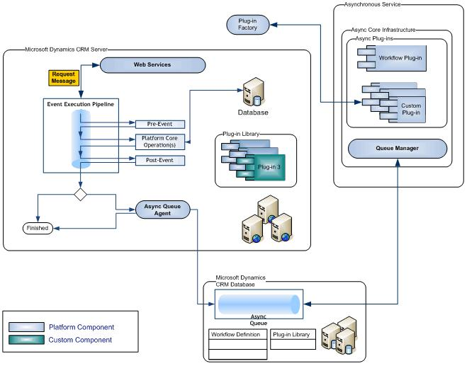
Event Execution Pipeline
Notes:
Features
Improved event processing subsystem – both plug-ins and workflow activities executed with same methods
Synchronous execution of plug-ins can be inside the database transaction whilst asynchronous plugins always run outside of the transaction.
Execution Pipeline
A request is made to the Dynmics 365 Organisation Web Service (a message is sent from custom code or application)
The information form the message (i.e. entity information etc) is passed to the event execution pipeline where platform operations and registered plug-ins read and modify the message
Synchronous plug-ins are called first (pre-event, post-event)
Async plug-ins are queued (added to the Async queue) using the Asynchronous Service Queue Manager
https://msdn.microsoft.com/en-us/library/gg327941.aspx

Slide 9
When Plugins Execute
Asynchronous
Uses more resources to track asynchronous work
Improves user’s perception of system performance because they are not waiting
Synchronous
Can highlight performance delays because user is blocked until operations are completed
Can give immediate feedback to user of operation success
Notes:
https://community.dynamics.com/crm/b/nunoscrmblog/archive/2017/06/29/real-time-workflow-vs-plugin-execution-order
Plugin steps are executed before than real-time workflows when both have set the same rank.
By default real-time workflows are executed before than plugins steps;

Slide 10
Plugin - Execution Pattern
Asynchronous | Synchronous
Does not block the user from seeing the result of the operation | Blocks the user until completed
Modifications happen after operation so Update call is required | Can modify data before CRM persists
Has extra overhead to track queued asynchronous op | Has minimal overhead to manage call
Limited to 2 minutes execution | Limited to 2 minutes execution
Can only run post operation | Can run post op or pre-operation
Not part of transaction | Included in transaction
Notes:
Synchronous Plugins should execute in a short time to prevent blocking the UI. But BOTH Synchronous and Asynchronous plugins will timeout after 2 minutes, which can effect debugging, Asynchronous good for calls to external systems, or anywhere where the operation is not imperative before execution returns to the user.

Slide 11
Pre/Post Event Images
Snapshot of Entity state from database before or after
Removes need to call Retrieve Request to get entity state during execution
Attributes to be imaged must be specified in registration
Sdk Message Processing Step Registration Images
Available via properties at runtime
Pre: Iplugin Execution Context Pre Entity Images
Post: Iplugin Execution Context Post Entity Images
Pre-Image and Post-Image aliases can be created through the Plugin Registration tool
Notes:
The Plugin Execution Context only receives data that has been entered or modified at that stage. Executing a request to read the original data values from the database would be timely, so a Pre-Image Alias will pass requested field values to the plugin execution context on an update or delete message request.
Likewise calculated columns or new record guids generated at the database would not be available to the Plugin Context except as part of a Post-Image Alias. Again it would be wasteful to request changes through a database query.
Pre-Image and Post-Image aliases can be created either through the Plugin Registration tool – Register New Image option, or if using the Developer Toolkit Visual Studio project template, Create a plugin on the entity and select the pre/post image alias in the dialog. Pre-Images can only be created on non create messages, and Post-Images can only be created on plugins registered to execute after the core database operation.

Slide 12
Notes:
The following code demonstrates the extraction of the pre-image alias from the plugin context, and casting the entity passed to an early bound type
//plugin class
private readonly string preImageAlias = "OldValues";
//Constructor of plugin class
IPluginExecutionContext context = localContext.PluginExecutionContext;
Entity preImageEntity = (context.PreEntityImages != null && context.PreEntityImages.Contains(this.preImageAlias)) ? context.PreEntityImages[this.preImageAlias] : null;
Contact previousContact = preImageEntity.ToEntity<Contact>();
Entity e =(Entity)localContext.PluginExecutionContext.InputParameters["Target"];
Contact currentContact=e.ToEntity<Contact>();
The secure and unsecure configuration boxes in the create plugin dialog allow for uncompiled data to be associated with the plugin execution context, like parameter values for algorithms, or messages. This data can be seen by Dynamics 365 admin or any user depending if secure or unsecure.
The data is available to the executing plugin by the data being passed to the plugins overloaded constructor. The following code shows the use of the unsecure configuration to pass in a string used for an Exception message.
public PluginAcceptingUseUncompiledConfiguration(string unsecure, string secure)
{
somePrivateVariable=unsecure;
If(!validateSomeAttribute())
{
throw new InvalidPluginExecutionException(somePrivateVariable);
}
}

Slide 13
Plugin Sandbox Isolation - Security
Designed to allow isolated code execution
Supports CRM Online and other multi-tenant scenarios
Robust tracking and code termination based on resource governor
Restrictions for Sandboxed Plug-ins:
Unable to access restricted resources such as the file system, registry, database, some web access, etc.
Unable to use reflection to access internal/private members of assemblies
Notes:
CRM online plugins must run in sandbox
Restricted Web Access from Sandbox
Only HTTP and HTTPS protocols are allowed
No localhost /127.0.0.1 access
Domain names must be fully qualified – IP Addresses not supported
Onpremise can modify restrictions via registry key
HKEY_LOCAL_MACHINE\SOFTWARE\Microsoft\MSCRM\
SandboxWorkerOutboundUriPattern
Outbound calls can be also disabled using SandboxWorkerDisableOutboundCalls key
Plugins can be registered to run under another users credentials (useful to access an audit table with restrictive access). The ImpersonatingUserId is the id of the assigned person, if this is not set then the ImpersonatingUserId is the same as the InitiatingUserId ( the account triggering the plugin)
Dynamics 365 plugins must run in the Sandbox Isolation mode.
https://community.dynamics.com/crm/b/crmbusiness/archive/2015/02/05/understanding-plugin-sandbox-mode

Slide 14
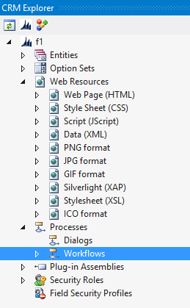
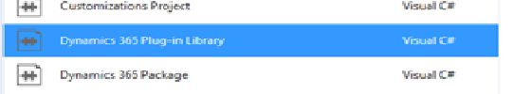
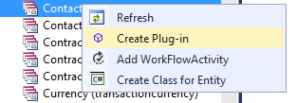
SDK – Developer Toolkit Project Template
Integrated with Visual Studio
Right Click From CRM Explorer to create a new plug-in
Plugin base class development pattern to minimize redundant code
Works with Dynamics Package Project template for deployment
Notes:
The Dynamics 365 Developer toolkit provides project templates for plugins, workflows and a package installer. On opening a new Dymanics Toolkit project, a wizard connects to the Dynamics 365 Server, through a Discovery Service call, then the selection of an Organization, and lastly the selection of a Dynamics 365 solution. The Dynamics 365 explorer window lets you drill down into the entities, optionsets, web resources, processes, plugins and security roles. Clicking on the items in the explorer opens the corresponding Dynamics 365 web pages, but in the tabbed windows of .Net rather than separate windows. Items can be edited and created through the explorer. Right clicking entities allows the creation of plugins, and an accompanying dialogue to set the entity, message, event stage, asynchronous or synchronous execution, execution order, security context, and pre/post Image aliases

Slide 15
Creating a Plugin Assembly
public class MyPlugin : IPlugin
{
public void Execute(IServiceProvider serviceProvider)
{
IPluginExecutionContext ctx = (IPluginExecutionContext) serviceProvider
if (ctx.InputParameters.Contains("Target") && ctx.InputParameters["Target"] is Entity)
{
// Obtain the target entity from the input parameters.
Entity contact = (Entity)ctx.InputParameters["Target"];
// Verify that the target entity represents a contact
// If not, this plug-in was not registered correctly.
if (contact.LogicalName != "contact")
{
return;
}
…
Notes:
If using the Developer Toolkit, a new plugin class is created that inherits from the project Plugin class (which implements Iplugin). The benefit of this is that the base class Plugin, provides a LocalPluginContext from which to extract pre an post images, the execution context (localContext.PluginExecutionContext) the initiating user etc, as well as an encapsulation of a Tracing service and OrganizationService
Without deriving from Developer Toolkit Plugin class to gain access to the OrganizationService would need to :
IOrganizationServiceFactory serviceFactory = (IOrganizationServiceFactory)serviceProvider.GetService(typeof(IOrganizationServiceFactory));
IOrganizationService service = serviceFactory.CreateOrganizationService(context.UserId);
Using the Toolkits class simply access the OrganizationService with:
localContext.OrganizationService

Slide 16
Notes:
It is good practice to keep plugin execution short, don’t update the entity that is the target entity, (infinite loop), don’t create a separate instance of the OrganizationService from the SDK API ,use the local plugin context, when using the developer toolkit. Note that recursion can not be accurately checked by
if (localContext.PluginExecutionContext.Depth>1)
{
return;
}
This is because the plugin may be being called through the execution of a previously running plugin. Instead to avoid unwanted recursion ( CRM will exception when it detects 8 callbacks), is to use SharedVariables. This a key/value dictionary that is shared between all the plugins executed within the pipeline from the same initial trigger.
You could then create a Boolean check to see if the plugin had previously been called and in
public static readonly Guid HasRunKey = new Guid("{6339dc20-01ce-4f2f-b4a1-0a1285b65bff}"); //or some value to show how plugin executed
And add this as the first step of the plugin:
if(context.SharedVariables.ContainsKey[HasRunKey])
{
return;
}
Else
{
context.SharedVariables.Add(HasRunKey);
// Proceed with plugin execution
}

Slide 17
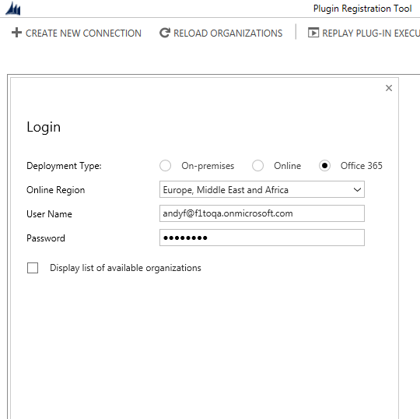
Registering and deploying plugins
Using the Plugin Registration Tool from the SDK
Using the Developer Toolkit, deploy the package
Notes:
With SDK
…SDK\Tools\PluginRegistration\PluginRegistration.exe
Create a new connection, and enter your credentials. This uses DiscoveryServices to find your OrganizationService., once connected Register assembly

Slide 18
Notes:
The Register New Step prompts the details of the message being processed; entity, message type(Create, Update etc), pipeline phase, Asynchronous, Rank, offline (outlook client)
If using the SDK – Developer Toolkit Project Template – the generation of a plugin by right clicking on an entity in the Dynamics 365 explorer defines the same properties as the Plugin Registration Tool Add Step
Once the plugin is created, strong named (signed) and built it can be registered and deployed using the Dynamics 365 Package project. This contains a RegisterFile.crmregister file with references to any assemblies and constituent classes that need to be registered.
The registration file defines the assembly names, id (once registered, names of the classes, stage, isolation level (must be sandbox for CRM online), Synchronous or Asynchonous mode (must be Asynchronous for plugins that run with Azure Services).
Simply build the CrmPackage projet and right click and deploy.

Slide 19
Debugging and Issues
Dynamics Online
Plugins must be isolated “sandbox”, and are restricted so that they can not load assemblies from the GAC, must be database deployed
Debug using the Plugin profiler (this is a process recorder that is registered on the CRM Server and is then replayed in the developer context to display the execution path)
All plugins must be strong named
On Premise
The .pdb file must be added to the CRM/Server/bin/assembly folder
Notes:
To sign an assembly with a strong name, it must have a public/private key pair. In Microsoft Visual Studio 2015, sign the assembly by following these steps:
1.Right-click the project and select Properties.
2.Select Signing.
3.Check Sign the assembly.
4.Select an existing key or create a new one.
5.Save the properties page.
6.Rebuild the DLL
Alternatively create a strong name key at the command line sn –k <your key file name>, reference this in the .Net Assembly and rebuild

Slide 20
Debugging – attach to process
Registration option | Process to attach
Running the application onpremise and no isolation | w3wp.exe
Running the application in offline mode | Microsoft.Crm.Application.Hoster.exe
Asynchronous Registered Plug-ins | CrmAsyncService.exe
Sandbox (Isolation Mode) | Microsoft.Crm.Sandbox.WorkerProcess .exe
Running Visual Studio as administrator, in the Debug menu
– attach to process, select appropriate process to debug and
Attach.

Slide 21
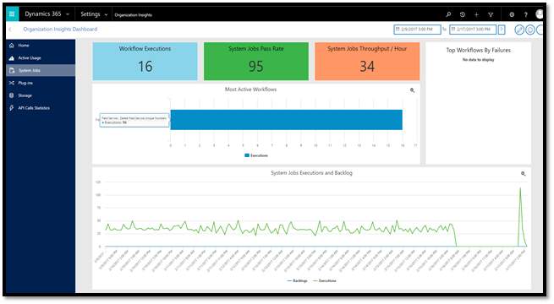
Organizational Insights
Notes:
Organizational Insights.
Organization Insights for Dynamics 365 (online) provides important adoption and usage metrics for your Dynamics 365 organization, and tools to help you stay ahead of performance and support issues.
Customize dashboards: Set up your organization’s dashboard to provide a rich user experience and snapshots of your organization’s most important data.
Monitor adoption and use: Identify your most active users, the number and types of operations they’re performing, number of page requests, most-used entities, workflows, plug-ins, and more, over a period of time as you work toward your adoption goals.
Manage storage and performance: Monitor storage quotas, storage use, and common tables by size to optimize performance.
Troubleshoot effectively: Drill down into the details of your top failing workflows and API calls to quickly diagnose and troubleshoot errors.
OData support: Organization Insights entities are exposed through OData for independent software vendors to build capabilities for any custom requirement

Slide 22
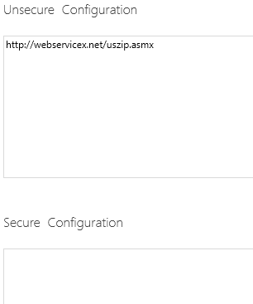
Plugin Configuration
// Plugin Constructor
public AddressResolver(string unsecureString, string secureString)
{
}
Secure configuration parameters can only be viewed by Dynamics 365 Administrators
Unsecure can be viewed by any user of the application.
Secure configuration parameters are not transportable between environments via a solution export/import
Notes:
A plugin can be configured via an optional constructor accepting two string parameters.

Slide 23
Debugging online
Using the CRM developer toolkit or the SDK Plugin registration tool, first register your plugin
For an online plugin it must be registered for sandbox isolation and database storage
Use the SDK Plugin registration tool, select the plugin assembly and then “Install Profiler”. After Installation the Plug-in Profiler is at the bottom of the list of assemblies
Notes:
First select the assembly to be profiled, then install profiler. Once installed select the step to be debugged, and select “start profiling”

Slide 24
Diagnostics
Prior to Crm 2016 the developer could return an exception from the plug-in back to CRM in a dialog window that allows the end user to “Download Log File”; or if the plug-in was registered asynchronously, the tracing information is shown in the System Jobs
In Dynamics 365, Settings – Administration – Customisations, set Plug-In and Custom Workflow Activity Tracking to ALL or Exception, and view under Settings - Plug-In Trace Logs
Plugin Profiler from Plugin Registration tool, either uses trace with log Exception, or holds record in Dynamics 365 Trace entity – this is the only available technique to debug online plugins

Slide 25
Module 5 Lab A
Creating a Custom Plug-In

Slide 26
Module 5 Lab B
Packaging a Custom Plug-In

Slide 27
Azure Integration

Slide 28
What is Service Bus?
Service Bus is a messaging solution for applications
Cloud hosted messaging middleware
For Intra-Application communication
Decoupling
Scalable
Resilient
Supports Hybrid communication
Spans cloud and On-Premises
Private or public access, from anywhere
Supports multiple devices and platforms
Enables various communication patterns
Notes:
Service Bus Benefits
Expose apps and services through firewalls, NAT gateways, and other problematic network boundaries
Lower barriers to building composite applications by exposing endpoints easily, supporting multiple connection options and publish and subscribe for multicasting.
Lightweight developer friendly programming model that supports standard protocols and extends similar standard bindings for WCF
Helps block malicious traffic and shields your services from intrusions and denial-of-service attacks

Slide 29
Key Features
Brokered Messaging
Service Bus Queues
Service Bus Topics
Connectivity
Service Bus Relays
Notifications
Service Bus Notification Hub
Notes:
Service Bus Features
Services discovered through a stable, internet-accessible URL, irrespective of location
One-way messaging between sender and listener supports unicast and multicast datagram distribution
Services discovered through a stable, internet-accessible URL, irrespective of location
Full-duplex connection-oriented sessions between sender and listener support bi-directional communication
Full-duplex, connection-oriented peer-to-peer sessions with network-boundary traversal create direct end-to-end connectivity through NAT
Multiple publishers and multiple subscribers can simultaneously use the service’s topic management and event distribution system
Support of REST and HTTP Access from non-.NET platforms
Global hierarchical namespaces that are DNS- and transport-independent
Anonymous access to services is supported only if you permit it

Slide 30
Service Bus Namespace Tree
[http|sb]://namespace.servicebus.windows.net/foo/bar/baz
Service Bus resources are organized in a tree with the Service Bus namespace as its root
Service Registry Root
/
foo
bar
baz
abc
boo
bee
pqr
def
ghi
Notes:
The various services supported by the Service Bus, including relayed and brokered messaging, are hosted at service paths under the service registry root:
https://{namespace}.servicebus.windows.net/{path}
For example, the following are valid service paths:
https://MyNS.servicebus.windows.net/topics/interestingtopic
https://MyNS.servicebus.windows.net/topic2/subscriptions/somesubscription
https://MyNS.servicebus.windows.net/EchoService/

Slide 31
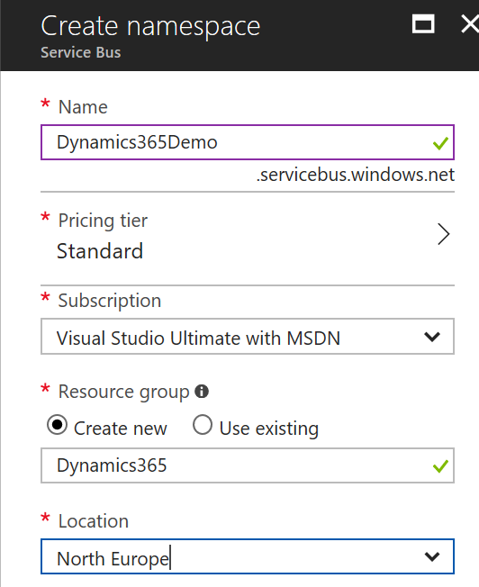
Creating a Service Bus Namespace
Notes:
Service Bus Namespaces can be created using the Azure Management Portal http://portal.azure.com
The namespace must be globally unique

Slide 32

Service Bus Queues
Ordered Message Log
Ordered by arrival
Time stamped on arrival
Hosted in Windows Azure by a replicated, durable store infrastructure
Two modes:
Pull – delivers messages on request
Allows for multiple concurrent readers
Forward – delivers messages to a single destination
App
App
App
App
Notes:
Queues offer First In, First Out (FIFO) message delivery to one or more competing consumers. That is, messages are typically expected to be received and processed by the receivers in the temporal order in which they were added to the queue, and each message is received and processed by only one message consumer. A key benefit of using queues is to achieve “temporal decoupling” of application components. In other words, the producers (senders) and consumers (receivers) do not have to be sending and receiving messages at the same time, because messages are stored durably in the queue. Furthermore, the producer does not have to wait for a reply from the consumer in order to continue to process and send messages.

Slide 33
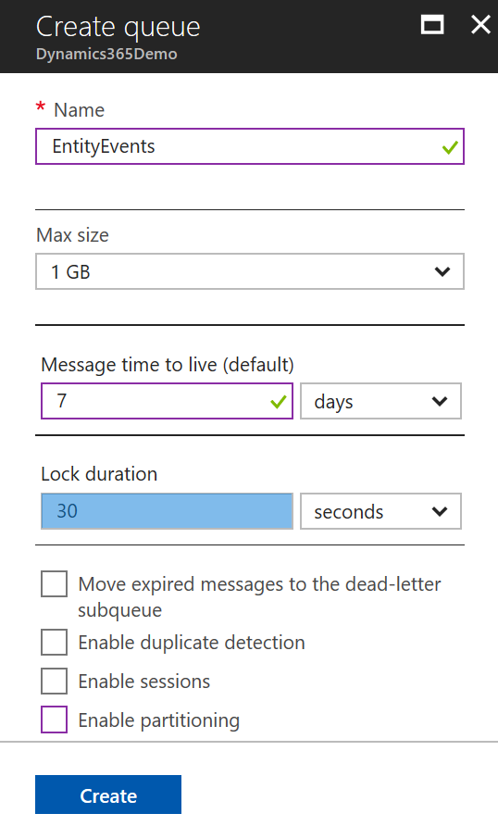
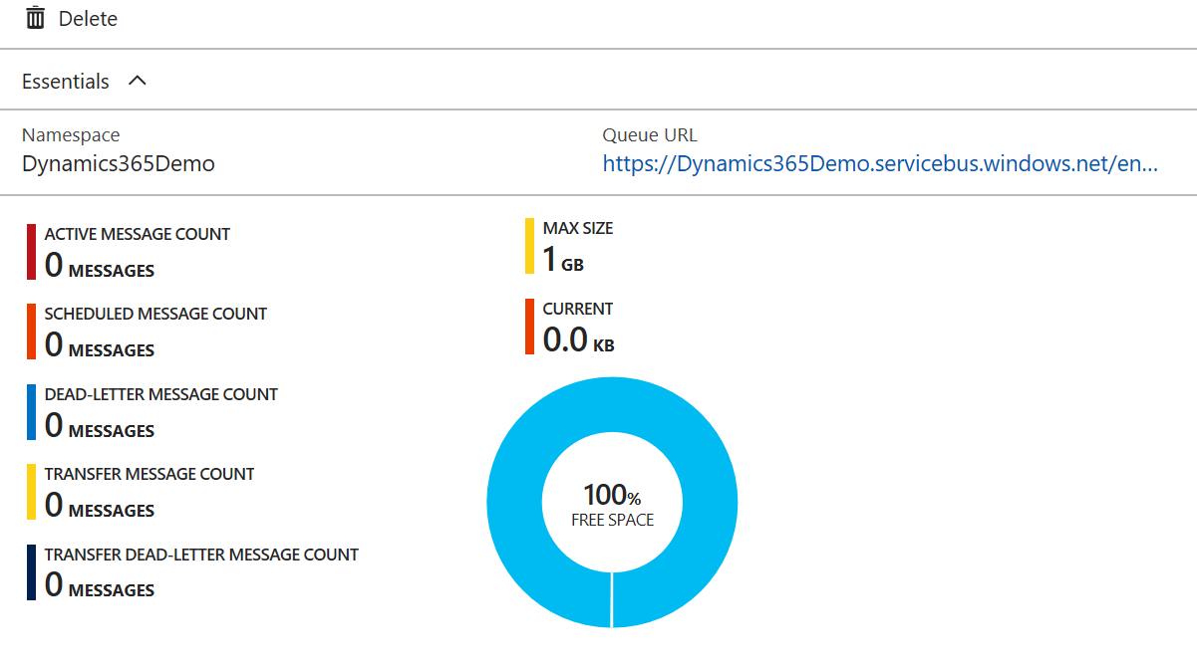
Creating a Service Bus Queue
Notes:
Queues can be created within a service bus namespace

Slide 34
Service Bus Topics
All the features of queues
Multiple independent subscriptions
Named, can be durable created
Max 2000 concurrent subscriptions per topic
Can create filters with rule conditions on message headers
Max 2000 rules per subscription
Controls what messages can be received
Topic ‘tail’ and subscription ‘head’ are fully compatible queues
App
App
App
Notes:
In contrast to queues, in which each message is processed by a single consumer, topics and subscriptions provide a one-to-many form of communication, in a “publish/subscribe” pattern. Useful for scaling to very large numbers of recipients, each published message is made available to each subscription registered with the topic. Messages are sent to a topic and delivered to one or more associated subscriptions, depending on filter rules that can be set on a per-subscription basis. The subscriptions can use additional filters to restrict the messages that they want to receive. Messages are sent to a topic in the same way they are sent to a queue, but messages are not received from the topic directly. Instead, they are received from subscriptions. A topic subscription resembles a virtual queue that receives copies of the messages that are sent to the topic. Messages are received from a subscription identically to the way they are received from a queue.

Slide 35
Service Bus Topics
Message Distribution
Each receiver gets its own copy of each message
Subscriptions are independent
Allows for many independent ‘taps’ into a message stream
Constrained Message Distribution (Partitioning)
Receivers get mutuality exclusive messages from the stream by creating filters
Topic
Receiver
SUB
Sender
SUB
Receiver
SUB
Receiver
SUB
Receiver
Notes:
Service Bus topics and subscriptions support a publish/subscribe messaging communication model. When using topics and subscriptions, components of a distributed application do not communicate directly with each other, they instead exchange messages via a topic, which acts as the intermediary.

Slide 36
Receiving Messages
Receive and Delete
Fastest
Message can be lost if receiver crashes
Peek Lock
When retrieved the message is locked and becomes invisible
Receiver calls complete (deleted) after processing the message
Message reappears and unlocks if not completed within the lock timeout
Can cause messages to be processed out of order
Session + Peek Lock
All messages with the same session-id are locked
Good For batch, in order processing
Notes:
Receiving Messages
Messages can be received from queues or subscriptions and the same techniques are used for both scenarios. The MessageReceiver class is used internally by the QueueClient and SubscriptionClient classes for receiving messages. Messages can also be received as sessions using the MessageSession class, which derives from MessageReceiver.
There are several techniques that can be used for receiving messages:
Receive and Delete Receive Mode
Peek Lock Receive Mode
Session + Peek Lock

Slide 37
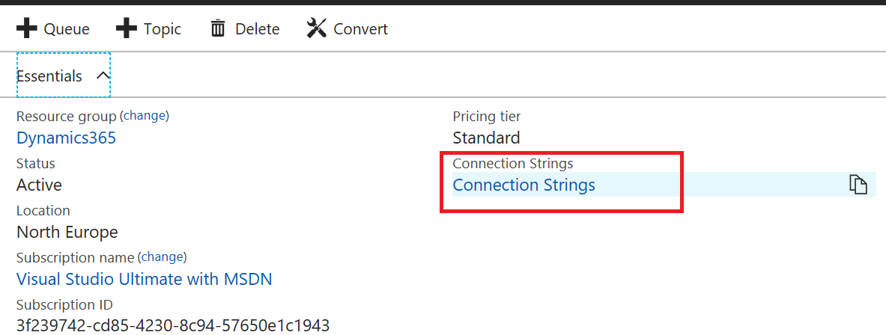
Connection Strings
Notes:
The Access to service bus resources is secured via keys and any request to read or write to a Queue, Topic, or Relay must use a valid connection request that includes a valid key. The connection strings for a service bus can be accessed from the portal.

Slide 38
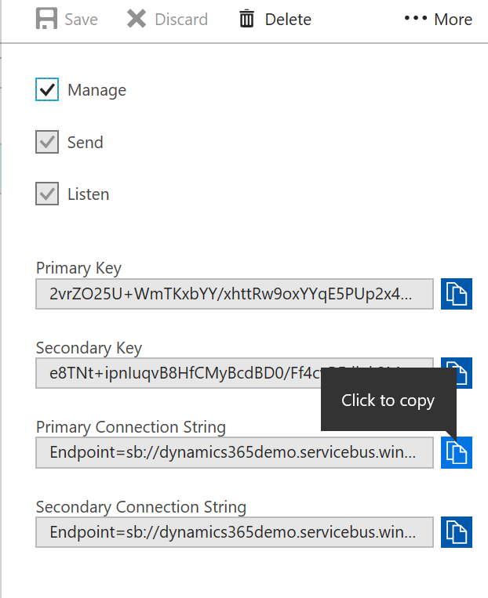
Connection Strings

Slide 39
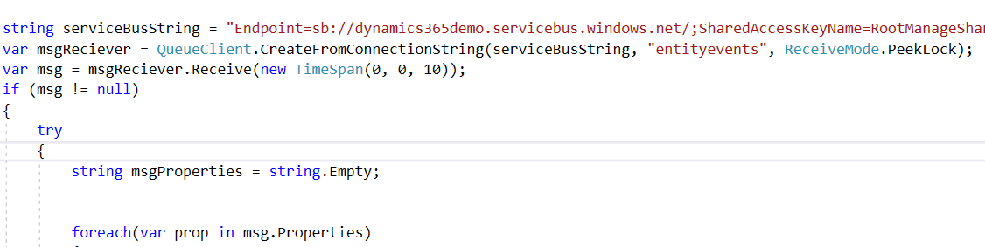
Receiving Queue Messages
The QueueClient is used for sending and receiving messages
Notes:
The easiest way to receive messages from a queue is to use a QueueClient object. This objects can work in two different modes: ReceiveAndDelete and PeekLock.
When using the ReceiveAndDelete mode, the receive is a single-shot operation - that is, when the Service Bus receives a read request for a message in a queue, it marks the message as consumed, and returns it to the application. ReceiveAndDelete mode is the simplest model and works best for scenarios in which an application can tolerate not processing a message in the event of a failure.
In PeekLock mode (which is the default mode), the receive becomes a two-stage operation, which makes it possible to support applications that cannot tolerate missing messages. When the Service Bus receives a request, it finds the next message to be consumed, locks it to prevent other consumers receiving it, and then returns it to the application. After the application finishes processing the message (or stores it reliably for future processing), it completes the second stage of the receive process by calling Complete on the received message. When the Service Bus sees the Complete call, it marks the message as being consumed and removes it from the queue.

Slide 40
Creating Service Bus Topics
Creating a Service Bus topic is similar to creating a Service Bus Queue
You can use:
Windows Azure Management Portal
Visual Studio 2015/17Azure Service Bus libraries for .NET
After creating a topic you have to create subscriptions for it
Topics cannot be used if they do not have subscriptions
NamespaceManager nm = new NamespaceManager.CreateFromConnectionString(connString);
var myTopic = nm.CreateTopic("TestTopic");
Notes:
In contrast to Service Bus queues, where each message is processed by a single consumer, topics and subscriptions provide a one-to-many form of communication, using a publish/subscribe pattern. It is possible to register multiple subscriptions to a topic. When a message is sent to a topic, it is then made available to each subscription to handle/process independently.
You can perform management operations for Service Bus topics and subscriptions via the NamespaceManager class in very much the same way as working with queues. You can use the TopicExists method on NamespaceManager objects to check if a topic with a specified name already exists within a service namespace.

Slide 41
Service Bus Relay
Leverages the WCF programming model with additional bindings
Exposes WCF services without opening corporate firewalls
Allows WCF to traverse NAT routers
No need for static IP addresses
Universal connectivity between WCF applications and devices
Supports multiple WCF messaging patterns:
Unicast/Multicast one-way message forwarding
Request-Response socket forwarding
Duplex-Point to Point
Notes:
The Service Bus Relay service enables you to build hybrid applications that run in both an Azure datacenter and your own on-premises enterprise environment. The Service Bus relay facilitates this by enabling you to securely expose Windows Communication Foundation (WCF) services that reside within a corporate enterprise network to the public cloud, without having to open up a firewall connection or requiring intrusive changes to a corporate network infrastructure.

Slide 42
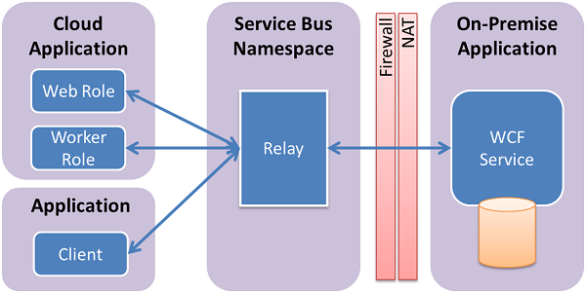
Service Bus Relay Architecture
Service Bus Relay acts as an intermediary endpoint between services
Enable seamless connections even through firewall and NAT router connections
Notes:
The Service Bus relay allows you to host WCF services within your existing enterprise environment. You can then delegate listening for incoming sessions and requests to these WCF services to the Service Bus running within Azure. This enables you to expose these services to application code running in Azure, or to mobile workers or extranet partner environments. The Service Bus allows you to securely control who can access these services at a fine-grain level. It provides a powerful and secure way to expose application functionality and data from your existing enterprise solutions and take advantage of it from the cloud.

Slide 43
Using the Service Bus Relay
Change the bindings on the WCF endpoints
Change the address and the binding to use the Azure Relay
address="sb://MyNameSpace.servicebus.windows.net/MyService"
<services>
<service name="Service.ProblemSolver">
<endpoint contract="Service.IProblemSolver"
binding="netTcpRelayBinding"
address="sb://**namespace**.servicebus.windows.net/solver"
behaviorConfiguration="sbTokenProvider"/>
</service>
</services>
Notes:
To expose an existing WCF SOAP web service for external consumption, you must make changes to the service bindings and addresses. This may require changes to your configuration file or it could require code changes, depending on how you have set up and configured your WCF services. Note that WCF allows you to have multiple network endpoints over the same service, so you can retain the existing internal endpoints while adding Service Bus endpoints for external access at the same time.
The Service Bus endpoint has an endpoint address beginning with the string "sb", then your namespace name, and the path "solver". This results in the URI "sb://[serviceNamespace].servicebus.windows.net/solver", identifying the service endpoint as a Service Bus TCP endpoint with a fully qualified external DNS name.

Slide 44
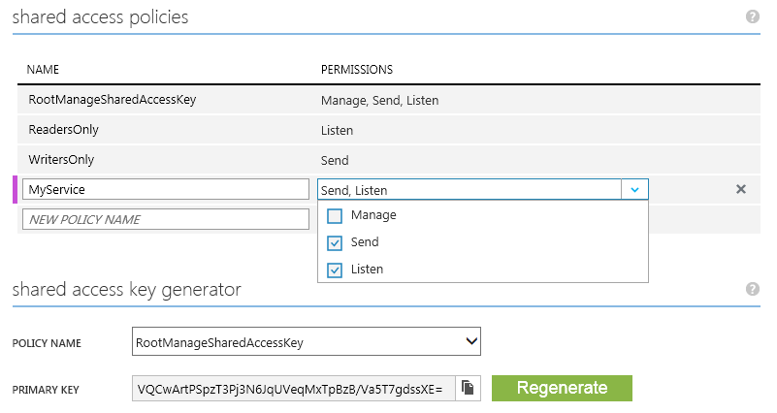
Service Bus Relay Security
Access is provided by SAS tokens
Generated in the portal
Can specify different policies for access tokens
Manager
Sender
Reader
Notes:
In order to perform management operations, such as creating a relay connection, you must obtain the management credentials for the namespace. In the Namespace you can create and view access tokens that control access to the relay. Copy the Key tokens as you will use this information to configure WCF behaviours to validate with the namespace.

Slide 45
Configuring Access Tokens
Specifying access token behaviour in WCF configuration
issuerName
issuerSecret
<behaviors>
<endpointBehaviors>
<behavior name="sbTokenProvider">
<transportClientEndpointBehavior>
<tokenProvider>
<sharedSecret issuerName="owner"
issuerSecret="0fr62JQ … … … … cSjtY=" />
</tokenProvider>
</transportClientEndpointBehavior>
</behavior>
</endpointBehaviors>
</behaviors>
Notes:
Applications that use the Windows Azure Service Bus are required to produce an authorisation token to gain access to the service. These can be configured programmatically or within the WCF configuration using the behaviour associated with the endpoint as in the slide.

Slide 46
Relay vs Message Broker
Brokers hold messages for retrieval and querying
The Relay routes messages straight through
Sender
Receiver
Sender
Receiver
Notes:
The messaging pattern associated with the initial releases of Microsoft Azure Service Bus is referred to as relayed messaging, but Service Bus also supports brokered messaging. The brokered messaging scheme can also be thought of as asynchronous messaging.
Relayed messaging provides many benefits, but requires the server and client to both be online at the same time in order to send and receive messages. This is not optimal for HTTP-style communication, in which the requests may not be typically long lived, nor for clients that connect only occasionally, such as browsers, mobile applications, and so on. Brokered messaging supports decoupled communication, and has its own advantages; clients and servers can connect when needed and perform their operations in an asynchronous manner.

Slide 47
Demo (Optional)
Demo relay service

Slide 48
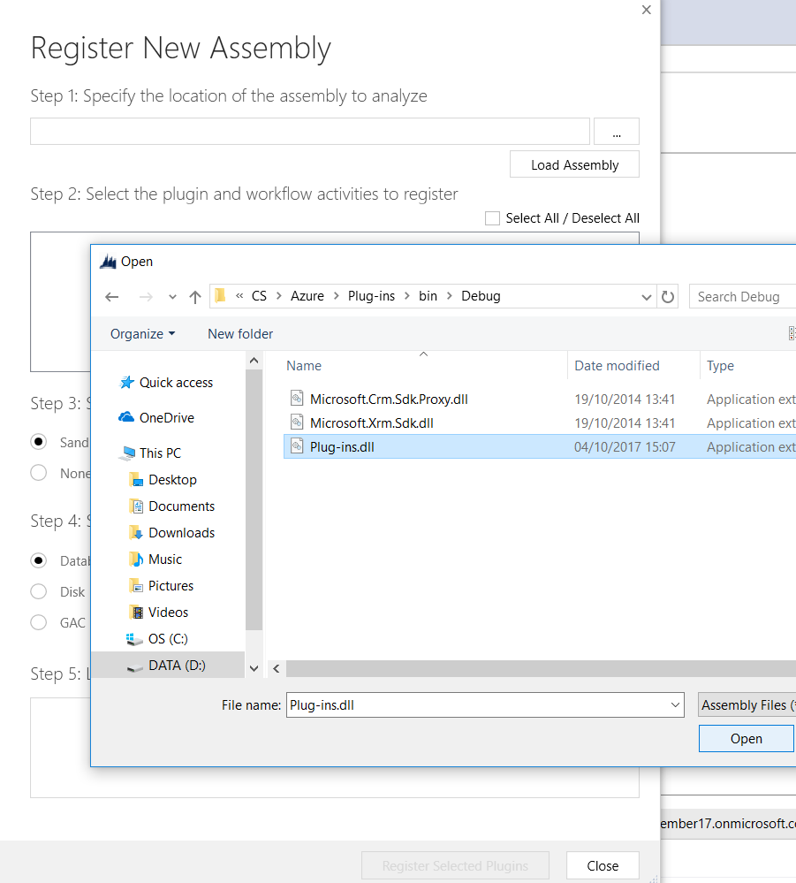
plug-in is provided with Dynamics 365 SDK
Notes:
An Azure-aware OOB plug-in is provided with Dynamics 365 and can be registered using the Plug-in Registration Tool in the SDK download. This plug-in executes in full trust with the Microsoft Dynamics 365 platform. You must register a plug-in 'step' in the event execution pipeline that identifies the message and entity combination that triggers the plug-in to execute and perform the posting notification. When executed, the plug-in notifies the asynchronous service, through a service endpoint notification service IServiceEndpointNotificationService, to post the current request data context to the Microsoft Azure Service Bus.
https://nishantrana.me/2017/03/22/configure-dynamics-365-and-azure-service-bus-integration-through-queue-and-queueclient/

Slide 49
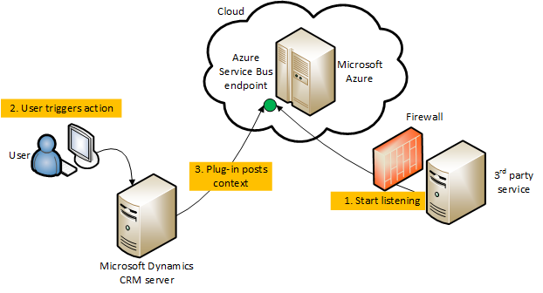
CRM – Azure Integration
Notes:
Key Integration Elements
The key elements that implement the integration between Microsoft Dynamics 365 and the Windows Azure platform AppFabric Service Bus include the following:
Asynchronous Service
The asynchronous service is responsible for posting the Microsoft Dynamics 365 remote execution context to the AppFabric Service Bus. Each post is performed by a system job of the asynchronous service. The status of each system job can be viewed by using the Microsoft Dynamics 365 web application.
Asynchronous Plug-ins
There are two kinds of asynchronous plug-ins supported by the integration feature: out-of-box (OOB) and custom. Synchronous plug-ins are not supported.
https://msdn.microsoft.com/en-us/library/gg334766.aspx

Slide 50
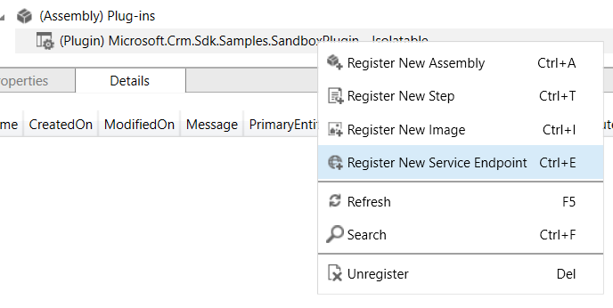
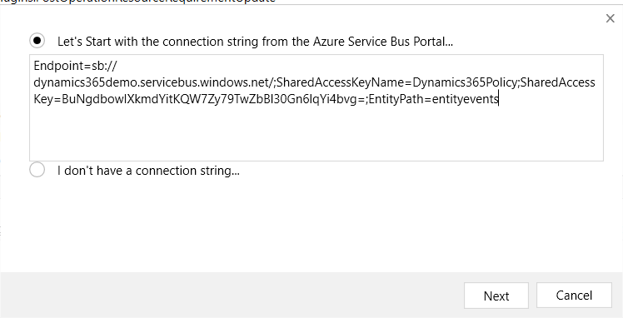
Register a New Service Endpoint
Notes:
The Service Bus endpoint must be added as one of possibly many endpoints. Each service endpoint has a unique Identifier that will be passed to the plugin

Slide 51
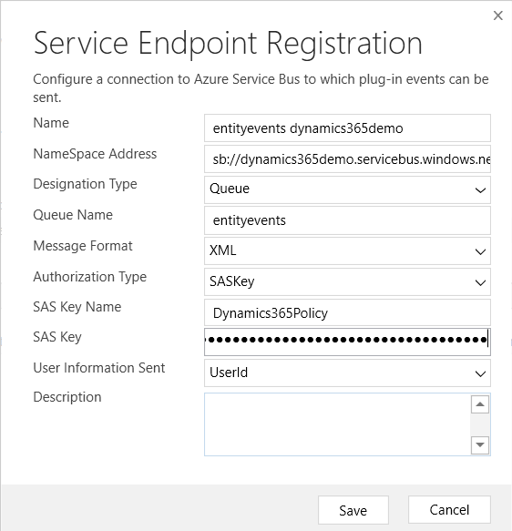
Choose the Format for the message body
Notes:
The message passed to the service has a head and body. The head contains property value parings that will include the id for the organisation ,the id of the User that the plugin impersonated while executing etc. The body will contain the entity information that was processed by the plugin. The format of the message body can be XML, JSON or Binary format.

Slide 52
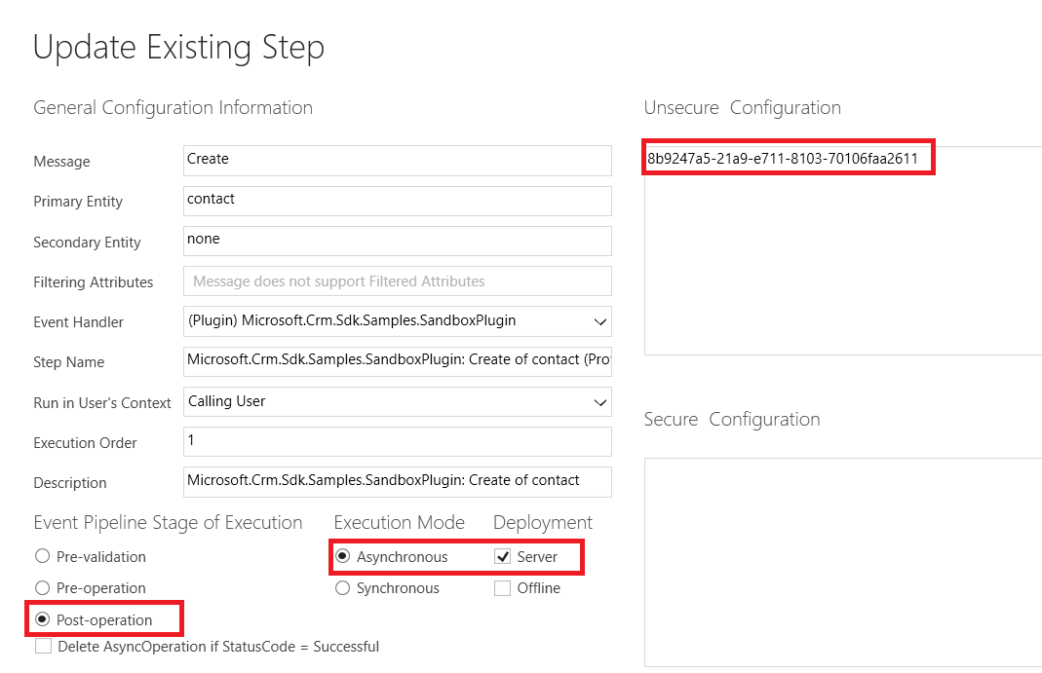
Notes:
The plugin MUST execute asynchronously , server side and configured with the id of the service endpoint, via it’s id.

Slide 53
Demo (Optional)
Azure Service Bus integration

Slide 54
Summary
Plugins define consistent server side business logic that can for example validate data input, perform calculations, send data to other systems
Plugins must be strongly named (signed before they can be registered)
The registering at different phases of the pipeline and the ordering of multiple plugins executing against the same message ensure that a business process sequence executes as intended
Creating plugins with the Developer Toolkit template, makes registering, and access to the organizationservice and tracing service easier

